Slide 1
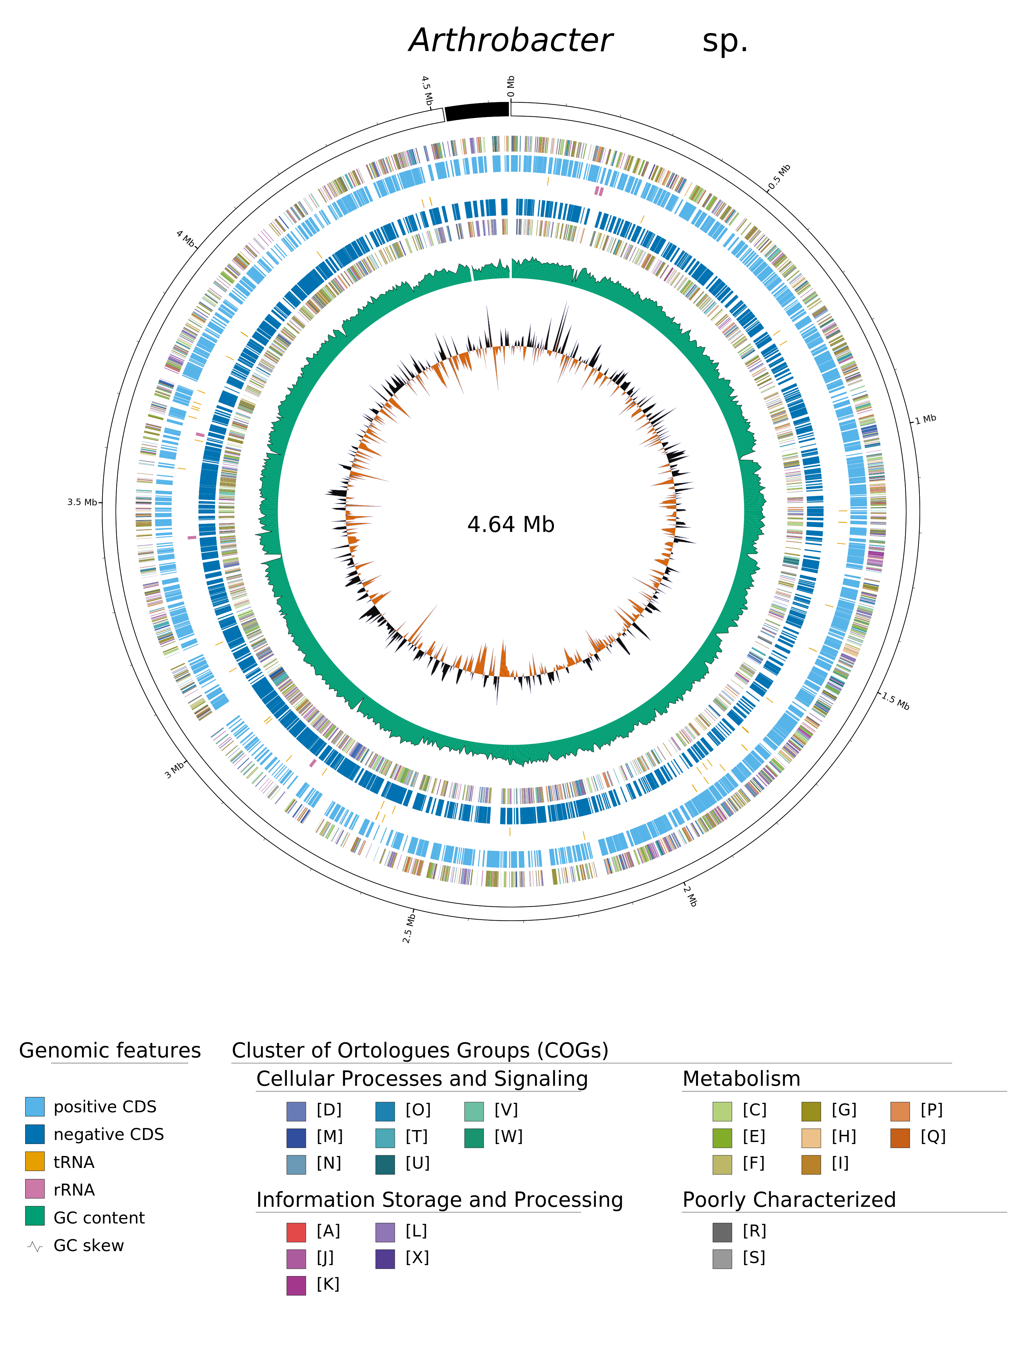
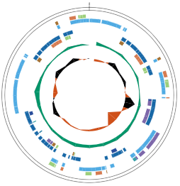
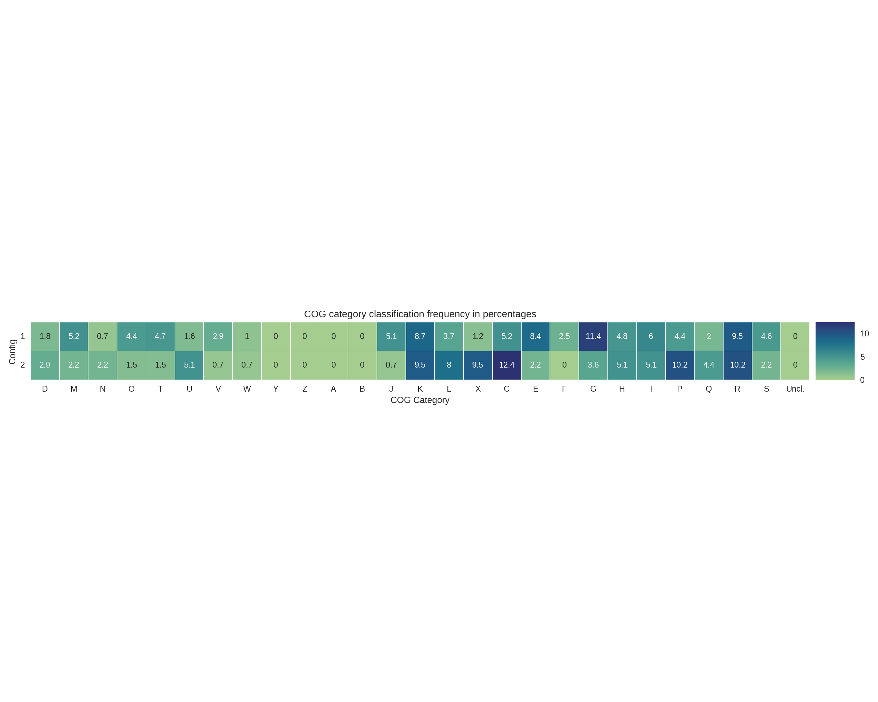
Figure 1
4.5 Mb
0 Mb
0.5 Mb
4 Mb
1 Mb
3.5 Mb
Arthrobacter nitrophenolicus
4.52 Mb
1.5 Mb
3 Mb
2 Mb
2.5 Mb

Slide 2
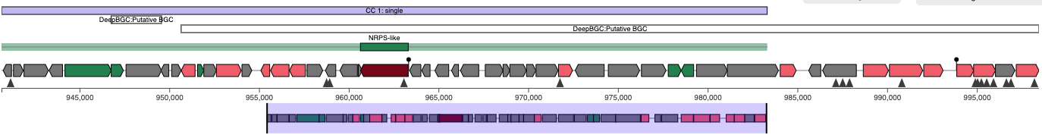
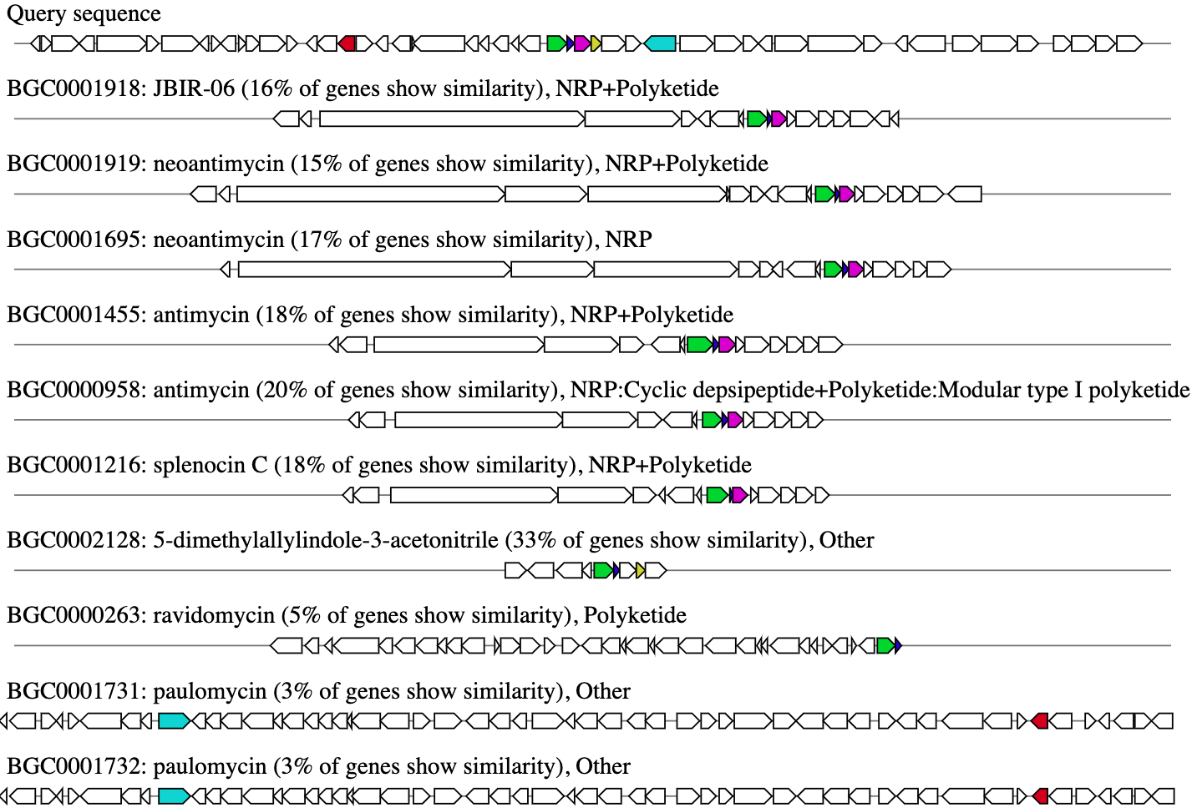
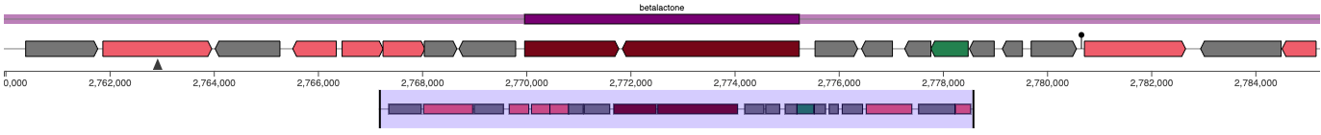
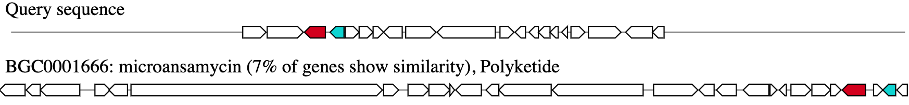
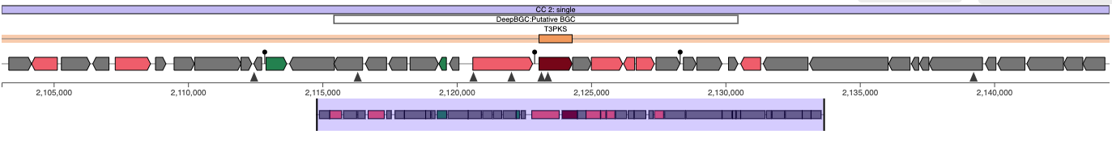
Figure 2
Biosynthetic (rule-based-clusters) NRPS-like: AMP-binding; biosynthetic (rule-based-clusters) NRPS-like: PP-binding; biosynthetic-additional (smcogs) SMCOG1002:AMP-dependent synthetase and ligase
DeepBGC : Putative BGC
NRPS-like
DeepBGC : Putative BGC
945,000
950,000
955,000
960,000
965,000
970,000
975,000
980,000
985,000
990,000
995,000
Query sequence
BGC0001918: JBIR-06 (16% of genes show similarity), NPR+Polyketide
BGC0001919: neoantimycin (15% of genes show similarity), NPR+Polyketide
BGC0001695: neoantimycin (17% of genes show similarity), NPR
NPRS-like biosynthetic gene clusters
BGC0001455: antimycin (18% of genes show similarity), NPR+Polyketide
BGC0000958: antimycin (20% of genes show similarity), NPR:Cyclic depsipeptide+Polyketide:Modular type I polyketide
BGC0001216: splenocin (18% of genes show similarity), NPR+Polyketide
BGC0002128: 5-dimethylallylindole-3-acetonitrile (33% of genes show similarity), Other
BGC0000263: ravidomycin (5% of genes show similarity), Polyketide
BGC0001731: paulomycin (3% of genes show similarity), Other
BGC0001732: paulomycin (3% of genes show similarity), Other
1
biosynthetic (rule-based-clusters) betalactone: AMP-binding
2
biosynthetic (rule-based-clusters) betalactone: HMGL-like
1
2
0,000
2,762,000
2,764,000
2,766,000
2,768,000
2,770,000
2,772,000
2,774,000
2,776,000
2,778,000
2,780,000
2,782,000
2,784,000
Betalactone
Query sequence
BGC0001666: microansamycin (7% of genes show similarity), Polyketide
SMCOG1024: chalcone and stilbene synthase domain protein
DeepBGC : Putative BGC
T3PKs
T3PKs
2,105,000
2,110,000
2,115,000
2,120,000
2,125,000
2,130,000
2,135,000
2,140,000
Legend

Slide 3
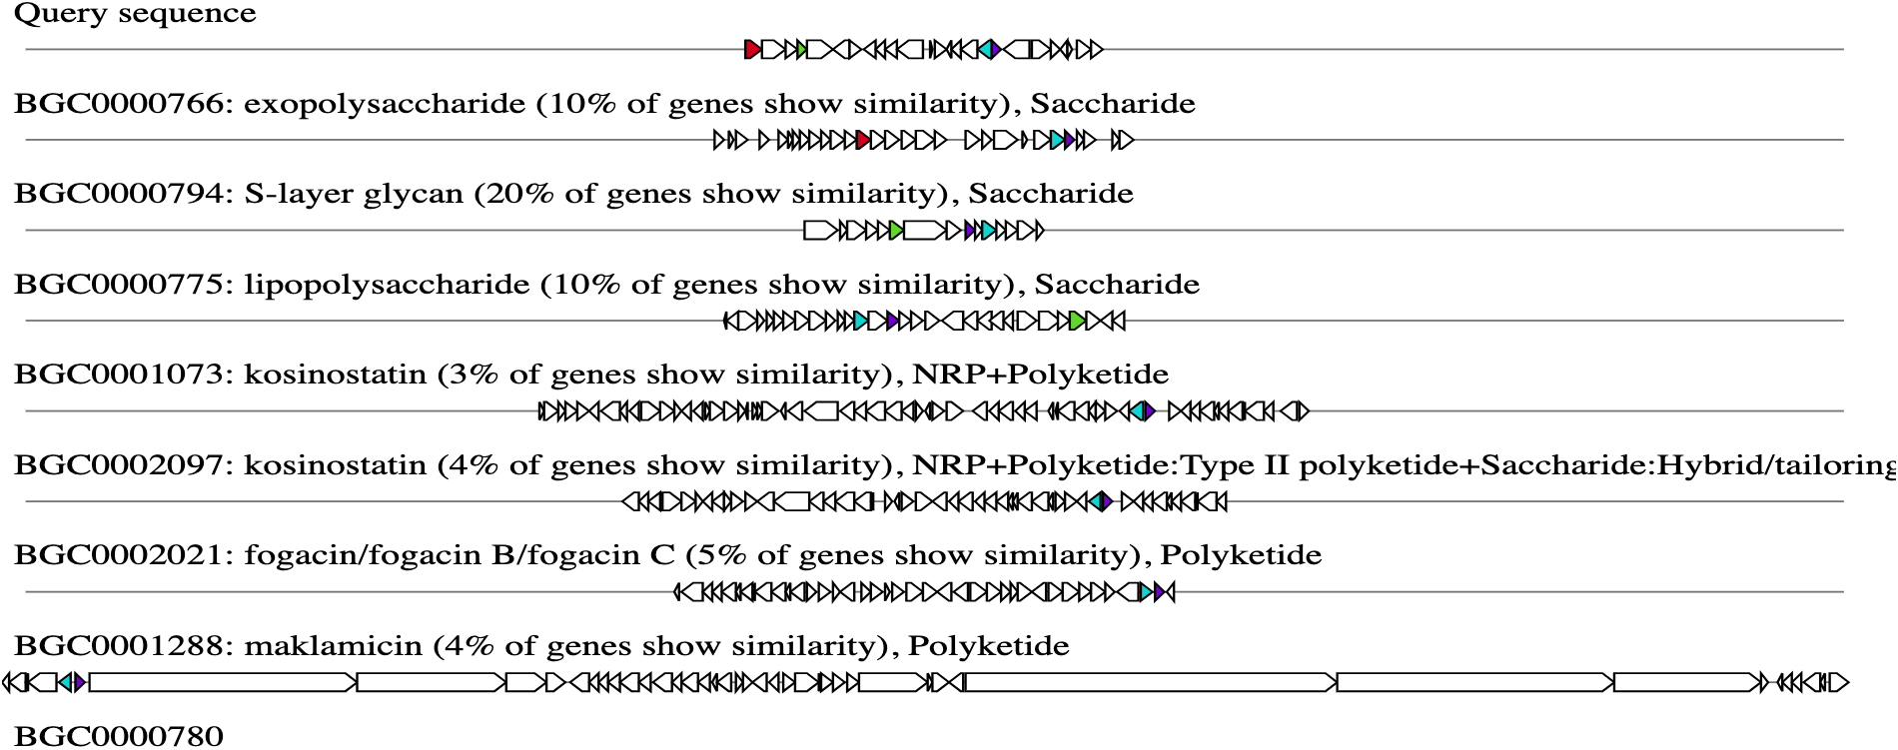
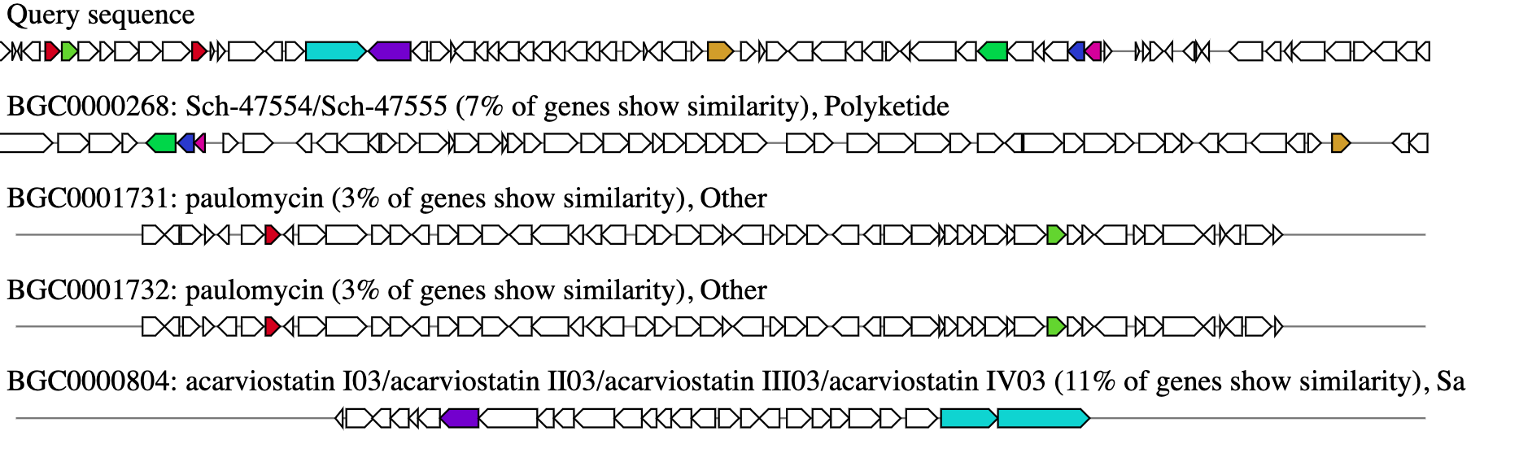
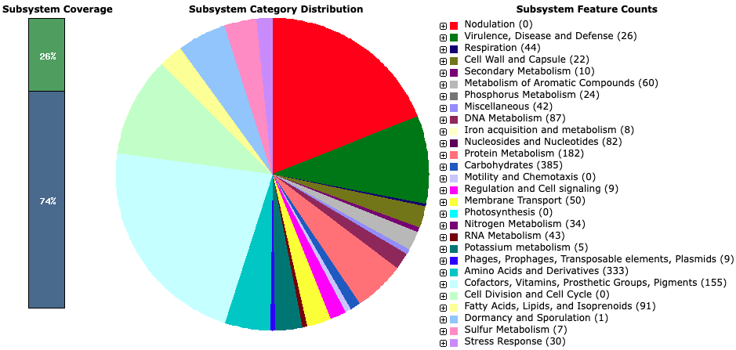
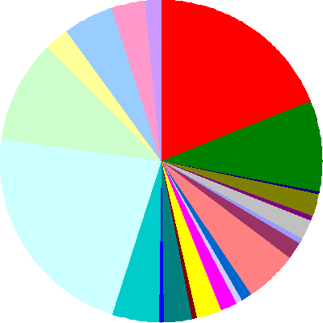


A
Biosynthetic-additional (rule-based-clusters) Glycos_transf_2
1,544,000
1,546,000
1,548,000
1,550,000
1,552,000
1,554,000
1,556,000
1,558,000
1,560,000
1,562,000
1,564,000
1,566,000
1,568,000
Query sequence
BGC0000766: exopolysaccharide (10% of genes show similarity), Saccharide
BGC0000794: S-layer glycan (20% of genes show similarity), Saccharide
Glycos_transf_2
BGC0000775: lipopolysaccharide (10% of genes show similarity), Saccharide
BGC0001073: kosinostatin (3% of genes show similarity), NRP+Polyketide
BGC0002097: kosinostatin (4% of genes show similarity), NRP+Polyketide:Type II polyketide+Saccharide: Hybrid/tailoring
BGC0002021: fogacin/fogacin B/fogacin C (5% of genes show similarity), Polyketide
BGC0001288: maklamicin (4% of genes show similarity), Polyketide
biosynthetic-additional (rule-based-clusters) Alpha-amylase; biosynthetic-additional (rule-based-clusters) Alpha-amylase C; biosynthetic-additional (smcogs) SMCOG1257:Alpha-glucosidase (Score:
4,030,000
4,040,000
4,050,000
4,060,000
4,070,000
4,080,000
4,090,000
4,100,000
Query sequence
Biosynthetic-additional
BGC0000268: Sch-47554/ Sch-47555 (7% of genes show similarity), Polyketide
BGC0000268: Paulomycin (3% of genes show similarity), Other
BGC0001732: Paulomycin (3% of genes show similarity), Other
BGC0000804: acarviostatin 103/acarviostatin II03/ acarviostatin III03/ acarviostatin IV03/ (11% of genes show similarity), Saccharide
B
Subsystem Coverage
Subsystem Category Distribution & Feature Counts
Nodulation (0)
Virulence, Disease, & Defense (26)
Respiration (44)
Cell Wall & Capsule (22)
26%
Secondary Metabolism (10)
Metabolism of Aromatic Compounds (60)
Phosphorous Metabolism (24)
Miscellaneous (42)
DNA Metabolism (87)
Iron acquisition & Metabolism (8)
Nucleosides & Nucleotides (82)
Protein Metabolism (182)
Carbohydrates (385)
Mobility & Chemotaxis (0)
Regulation & Signaling (9)
74%
Membrane transport (50)
Photosynthesis (0)
Nitrogen Metabolism (34)
RNA Metabolism (43)
Potassium Metabolism (5)
Phages, Prophages, Transposable elements, & Plasmids (9)
Amino Acids & Derivatives (333)
Cofactors, Vitamins, Prosthetic Groups Acids, Pigments (155)
Cell division & Cell Cycle (0)
Fatty Acids, Lipids, & Isoprenoids (91)
Dormancy & Sporulation (1)
Sulfur Metabolism (7)
Figure S1
Stress Response (30)

Slide 4
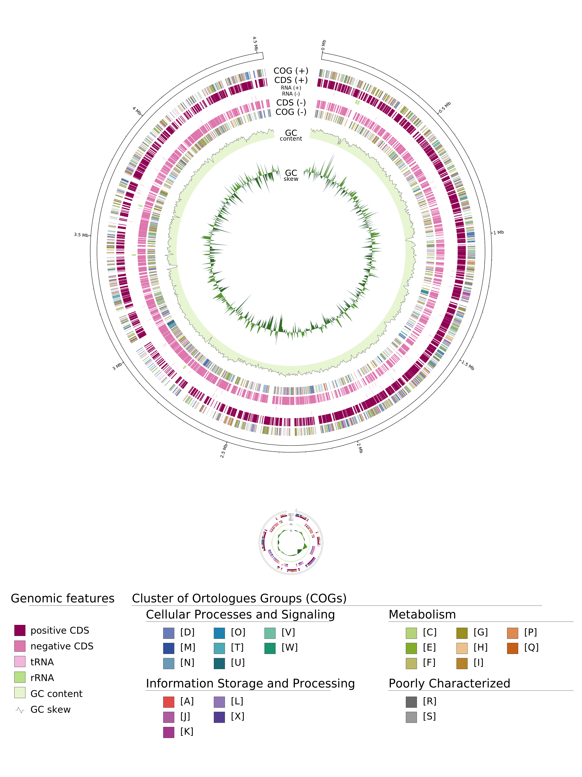
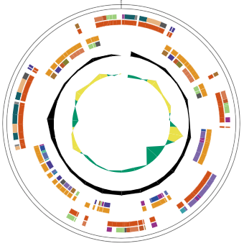
4.5 Mb
0 Mb
4.0 Mb
0.5Mb
3.5 Mb
Arthrobacter nitrophenolicus
1Mb
4.52 Mb
3 Mb
1.5Mb
2.5 Mb
2 Mb

Slide 5
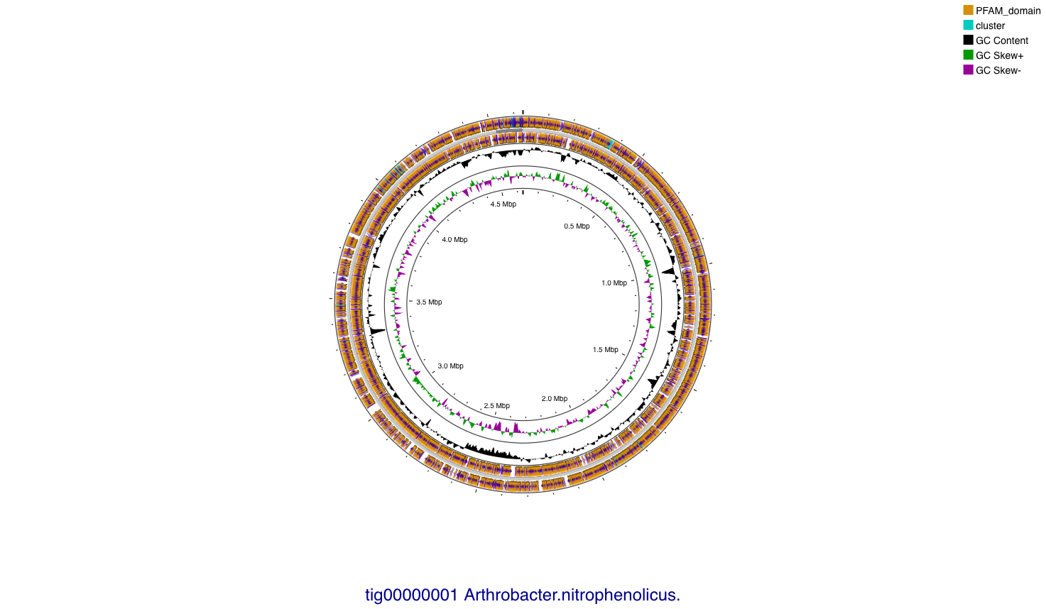
Arthrobacter nitrophenolicus
4.52 Mb

Slide 6
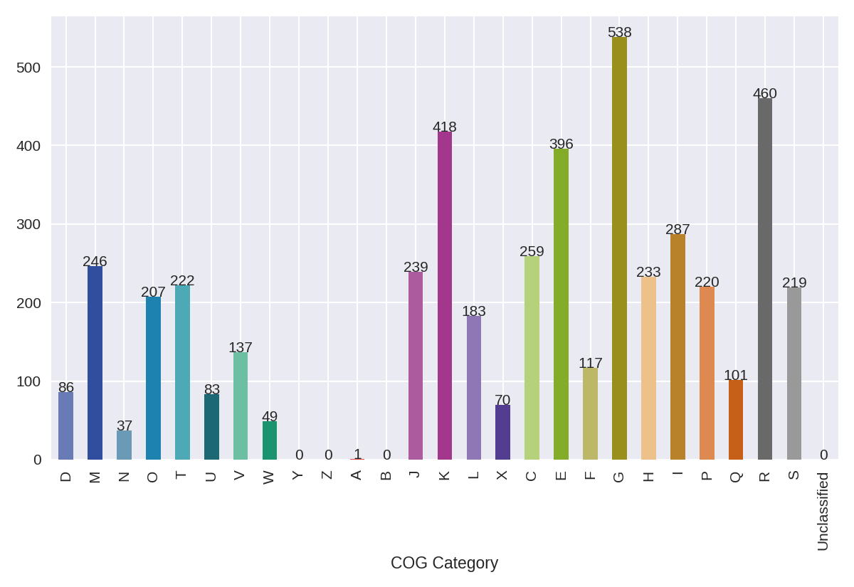

Slide 8
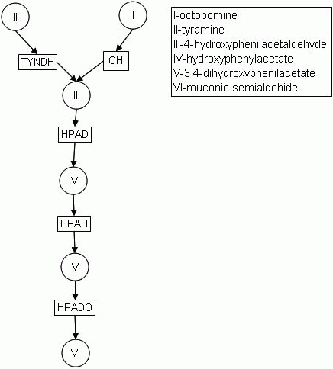
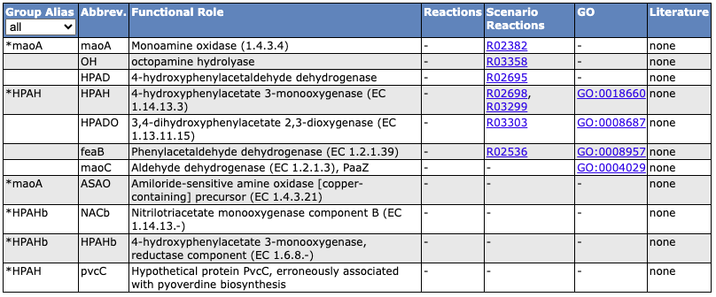
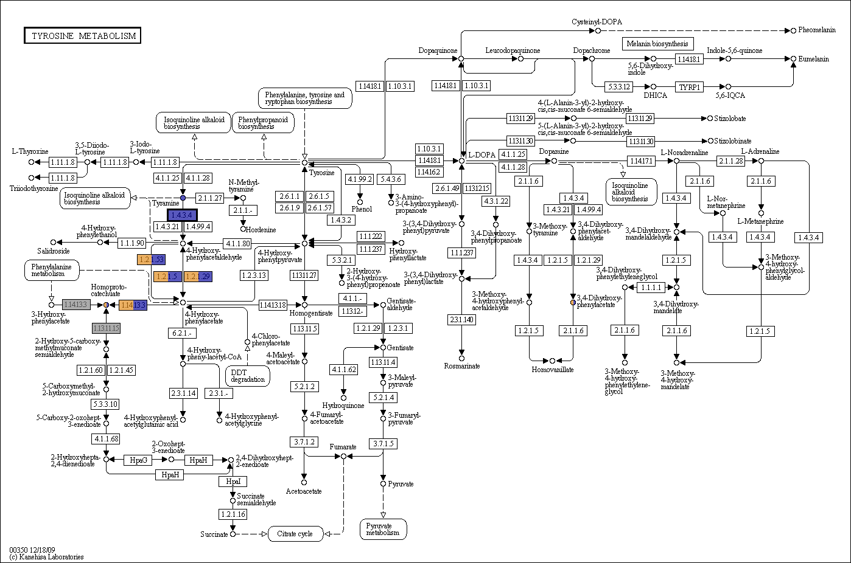
Subsystem: Aromatic Amin Catabolism

Slide 9
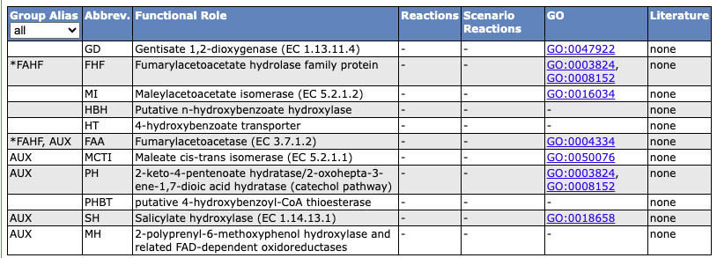
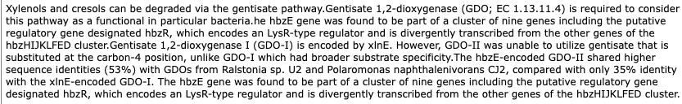
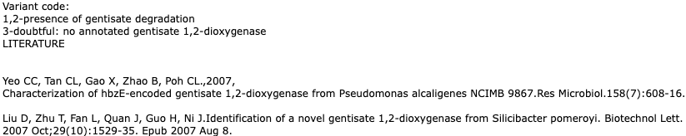
Subsystem: Gentisate degradation

Slide 10
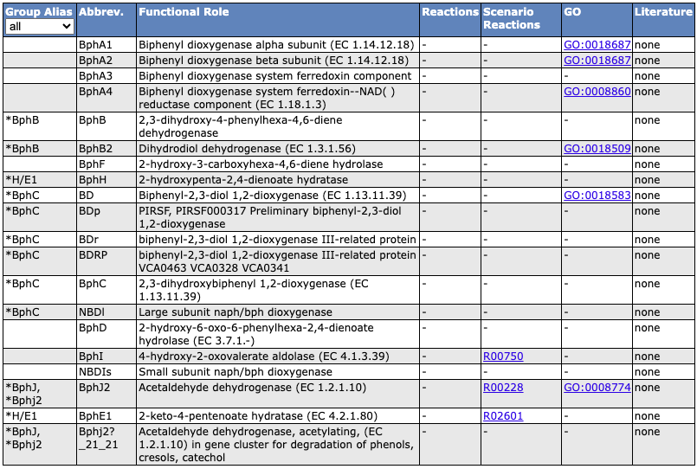
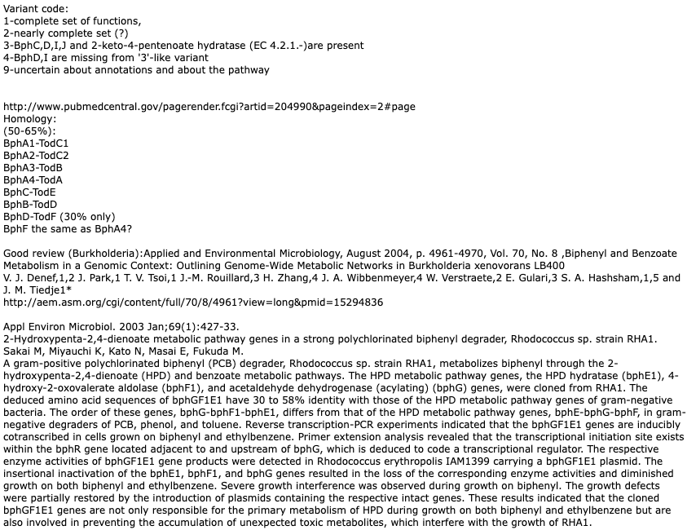
Subsystem: Gentisate degradation

Slide 11
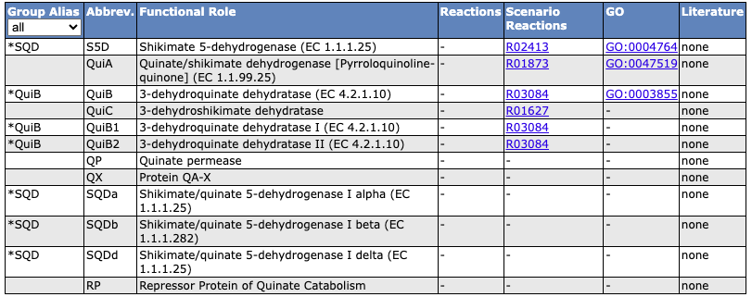
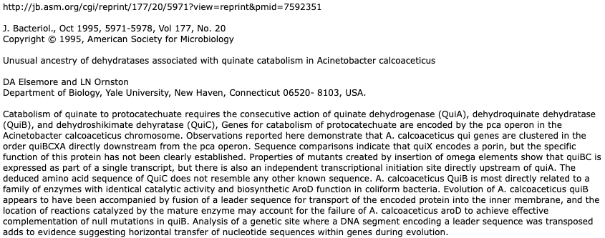
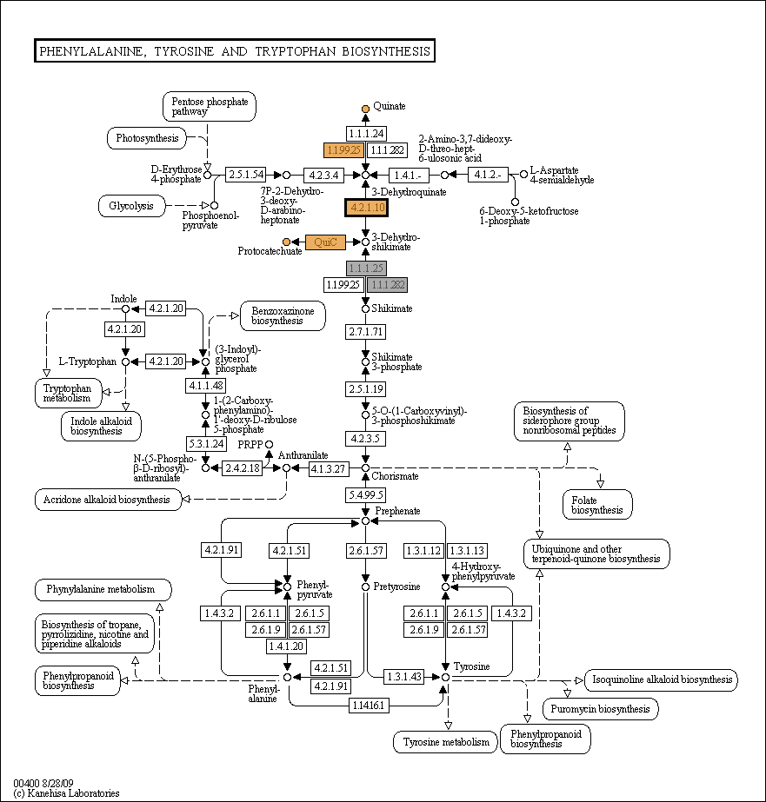
Subsystem: Quinate degradation

Slide 12
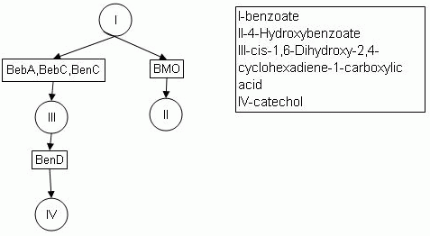
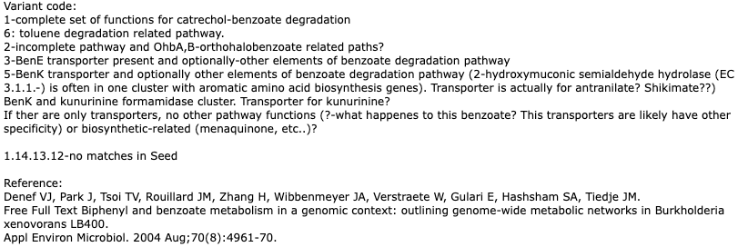
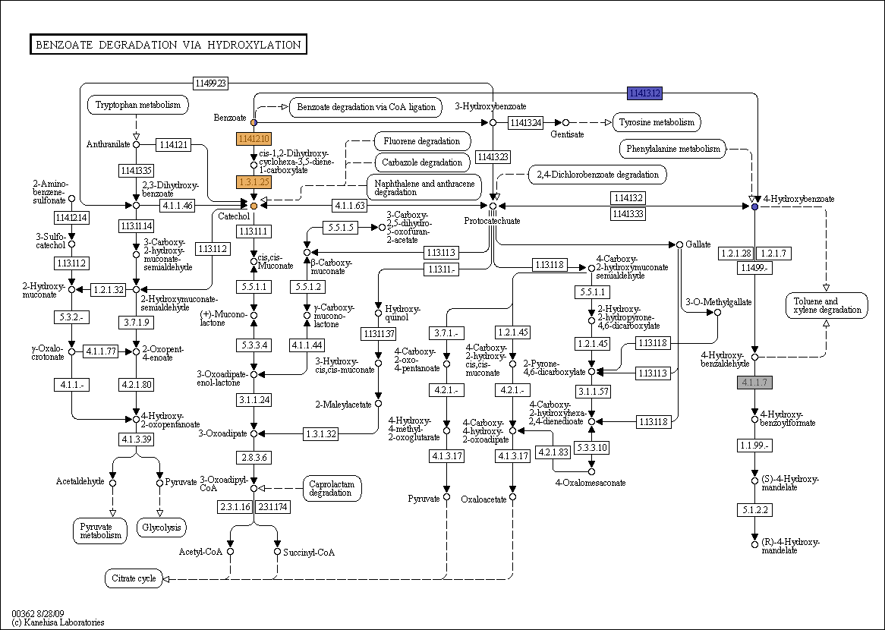
Subsystem: Benzoate degradation
Several pathways of degradation of benzoate-like compounds are combined in this SS.

Slide 13
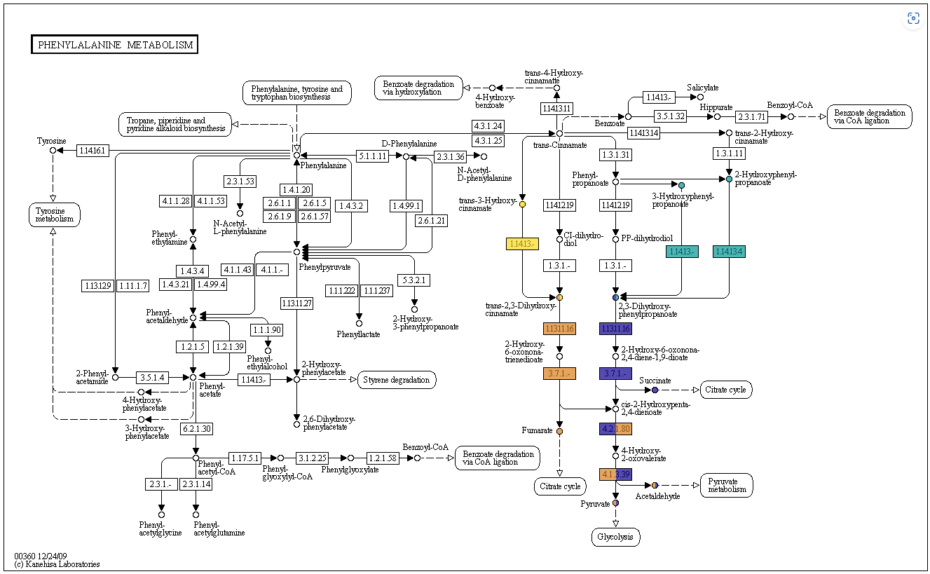
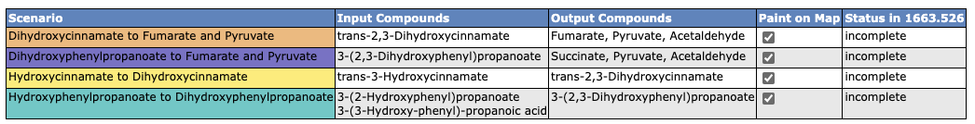
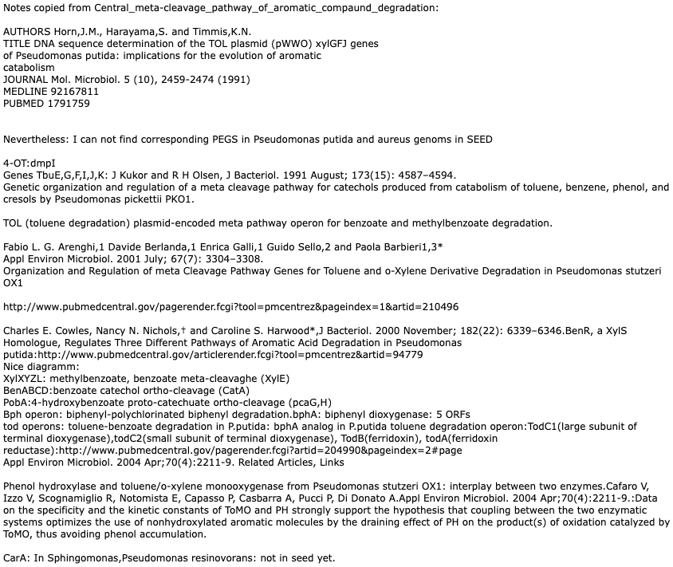
Metabolism of central aromatic intermediates (41): Central meta-cleavage pathway of aromatic compound degradation
Functions comprising Central meta-cleavage pathway are combined in this SS with some downstream pathways. It is done to preserve gene clusters which help to distinguish a specificity of each pathway.

Slide 14
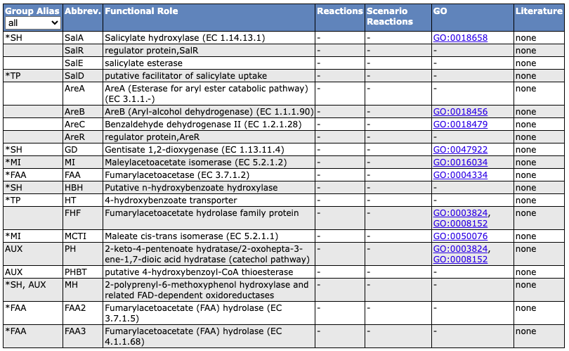
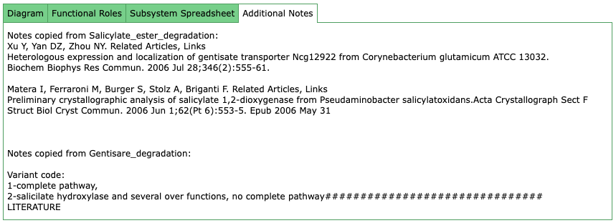
Metabolism of central aromatic intermediates (41): Salicylate and gentisate catabolism (8)

Slide 15
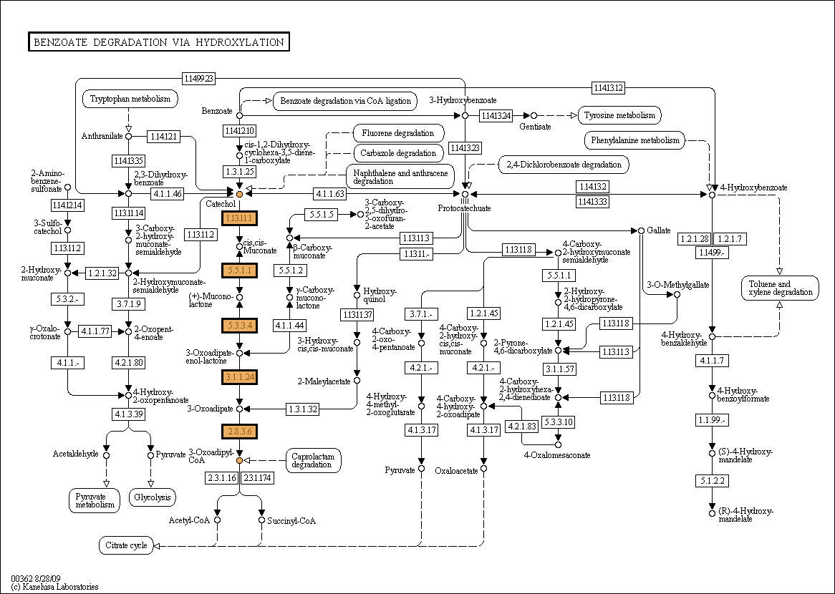
Metabolism of central aromatic intermediates (41): Catechol branch of beta-ketoadipate pathway
The beta-ketoadipate pathway is a chromosomally encoded convergent pathway for aromatic compound degradation that is widely distributed in soil bacteria and fungi. One of its branches converts catechol, generated from various aromatic hydrocarbons, amino aromatics, and lignin monomers into beta-ketoadipate. Two additional steps accomplish the conversion of beta-ketoadipate to tricarboxylic acid cycle intermediates making the catechol degradation pathway an effective route for utilization of carbon and energy. The catechol branch of the beta-ketoadipate pathway appears to be the evolutionary precursor for portions of the plasmid-borne ortho-pathways for chlorocatechol degradation. In the face of enzyme conservation, the beta-ketoadipate pathway exhibits many permutations in different bacterial groups with respect to enzyme distribution (isozymes, points of branch convergence), regulation (inducing metabolites, regulatory proteins), and gene organization. Diversity is also evident in the behavioral responses of different bacteria to beta-ketoadipate pathway-associated aromatic compounds. The presence and versatility of transport systems encoded by beta-ketoadipate pathway regulons is just beginning to be explored in various microbial groups. catBCDE genes from Acinetobacter calcoaceticus were isolated and characterised in 1986 ( J Bacteriol. 1986 Feb;165(2):557-63). catA and catBC gene cluster was selected from a gene bank of the Pseudomonas aeruginosa PAO1c chromosome in 1988 (J Bacteriol. 1988 Oct;170(10):4458-65). The catA, catB, and catC genes encode enzymes that catalyze consecutive reactions in the catechol branch of the beta-ketoadipate pathway: catA, catechol-1,2-dioxygenase (EC 1.13.11.1); catB, muconate lactonizing enzyme (EC 5.5.1.1); and catC, muconolactone isomerase (EC 5.3.3.4). For more information, please check out the description and the additional notes tabs, below
Variant code: 1,3-Complete functional sets 8-Muconolactone isomerase (EC 5.3.3.4) is missing 9-Catechol 1,2-dioxygenase (EC 1.13.11.1) is missing 5,4-Muconolactone isomerase (EC 5.3.3.4) and Catechol 1,2-dioxygenase (EC 1.13.11.1) are missing 7- other aromatic compound degradation Referensec and abstacts: The beta-ketoadipate pathway and the biology of self-identity. Harwood CS, Parales RE. Department of Microbiology, University of Iowa, Iowa City 52242, USA. The beta-ketoadipate pathway is a chromosomally encoded convergent pathway for aromatic compound degradation that is widely distributed in soil bacteria and fungi. One branch converts protocatechuate, derived from phenolic compounds including p-cresol, 4-hydroxybenzoate and numerous lignin monomers, to beta-ketoadipate. The other branch converts catechol, generated from various aromatic hydrocarbons, amino aromatics, and lignin monomers, also to beta-ketoadipate. Two additional steps accomplish the conversion of beta-ketoadipate to tricarboxylic acid cycle intermediates. Enzyme studies and amino acid sequence data indicate that the pathway is highly conserved in diverse bacteria, including Pseudomonas putida, Acinetobacter calcoaceticus, Agrobacterium tumefaciens, Rhodococcus erythropolis, and many others. The catechol branch of the beta-ketoadipate pathway appears to be the evolutionary precursor for portions of the plasmid-borne ortho-pathways for chlorocatechol degradation. However, accumulating evidence points to an independent and convergent evolutionary origin for the eukaryotic beta-ketoadipate pathway. In the face of enzyme conservation, the beta-ketoadipate pathway exhibits many permutations in different bacterial groups with respect to enzyme distribution (isozymes, points of branch convergence), regulation (inducing metabolites, regulatory proteins), and gene organization. Diversity is also evident in the behavioral responses of different bacteria to beta-ketoadipate pathway-associated aromatic compounds. The presence and versatility of transport systems encoded by beta-ketoadipate pathway regulons is just beginning to be explored in various microbial groups. It appears that in the course of evolution, natural selection has caused the beta-ketoadipate pathway to assume a characteristic set of features or identity in different bacteria. Presumably such identities have been shaped to optimally serve the diverse lifestyles of bacteria. FEMS Microbiol Lett. 2003 Sep 12;226(1):151-7. Related Articles, Links An inducible Streptomyces gene cluster involved in aromatic compound metabolism. Park HJ, Kim ES. School of Chemical Engineering and Biotechnology, Inha University, 402-751, Incheon, South Korea. Streptomyces setonii (ATCC 39116) is a thermophilic soil actinomycete capable of degrading single aromatic compounds including phenol and benzoate via the ortho-cleavage pathway. Previously, a 6.3-kb S. setonii DNA fragment containing a thermophilic catechol 1,2-dioxygenase (C12O) gene was isolated and functionally overexpressed in Escherichia coli (An et al., FEMS Microbiol. Lett. 195 (2001) 17-22). Here the 6.3-kb S. setonii DNA fragment was shown to be organized into two putative divergently transcribed gene clusters with six complete and one incomplete open reading frames (ORFs). The first cluster with three ORFs showed homologies to previously known benA, benB, and benC, implying it is a part of the benzoate catabolic operon. The second cluster revealed an ortho-cleavage catechol catabolic operon with three translationally coupled ORFs (in order): catR, a putative LysR-type regulatory gene; catB, a muconate cycloisomerase gene; catA, a C12O gene. Each of these individually cloned ORFs was expressed in E. coli and identified as a distinct protein. The expression of the cloned S. setonii catechol operon was induced in Streptomyces lividans by specific single aromatic compounds including catechol, phenol, and 4-chlorophenol. A similar induction pattern was also observed using a luciferase gene-fused reporter system. 8,9,10 entries are included for a moment for not to miss a right but misannotated function in a genome. Gene Cloning: J Bacteriol. 1988 Oct;170(10):4458-65

Slide 16
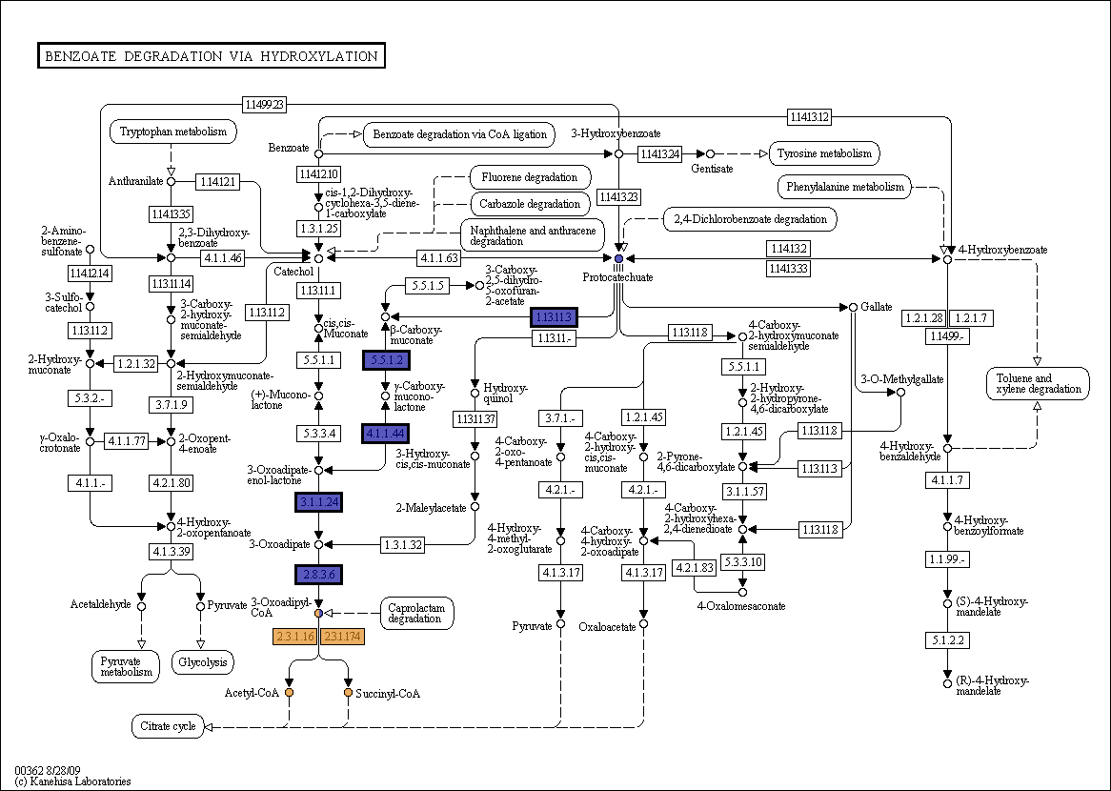
Metabolism of central aromatic intermediates (41): Protocatechuate branch of beta-ketoadipate pathway
Aromatic compounds represent an important source of energy for soil-dwelling organisms. The beta-ketoadipate pathway is a key metabolic pathway involved in the catabolism of the aromatic compounds protocatechuate and catechol. Metabolism of many plant derived compounds (phenylpropanoids and isoflavanones) , such as isovanillate (iVan; 3-hydroxy-4-methoxybenzoate), vanillate (Van; 4-hydroxy-3-methoxybenzoate), and veratrate (Ver; 3,4-dimethoxybenzoate) proceeds via protocatechuate (Pca; 3,4-dihydroxybenzoate)( J Bacteriol. 2006 Jun;188(11):3862-9.,Sci China C Life Sci. 2005 Jun;48(3):241-9). Protocatechuate is itself an abundant plant products and can serve, along with a large number of other aromatic or hydroaromatic compounds, as growth substrates for such bacteria as Acinetobacter. There is also growing interest in the development and optimization of bioremediation processes to deal with environments with high salinity that are contaminated with aromatic compounds. Many enviromental pollutants are degraded via protocatechuate by halophilic bacteria.
Appl Environ Microbiol. 2005 Feb;71(2):1025-34). (FEMS Microbiol Ecol. 2005 Sep 1;54(1):97-109) . Variant code: 1-complete set, 8-complete set with Succinyl-CoA-..transferase instead of 3-oxoadipate CoA-transferase (annotation problem?) 3-complete set without pcaQ-regulator 2,4-branch downstream oxoadipate is missing 6,7,8-incomplete sets 9-questionable sets, to check Additional references, abstracts. The beta-ketoadipate pathway and the biology of self-identity. Harwood CS, Parales RE. Department of Microbiology, University of Iowa, Iowa City 52242, USA. The beta-ketoadipate pathway is a chromosomally encoded convergent pathway for aromatic compound degradation that is widely distributed in soil bacteria and fungi. One branch converts protocatechuate, derived from phenolic compounds including p-cresol, 4-hydroxybenzoate and numerous lignin monomers, to beta-ketoadipate. The other branch converts catechol, generated from various aromatic hydrocarbons, amino aromatics, and lignin monomers, also to beta-ketoadipate. Two additional steps accomplish the conversion of beta-ketoadipate to tricarboxylic acid cycle intermediates. Enzyme studies and amino acid sequence data indicate that the pathway is highly conserved in diverse bacteria, including Pseudomonas putida, Acinetobacter calcoaceticus, Agrobacterium tumefaciens, Rhodococcus erythropolis, and many others. The catechol branch of the beta-ketoadipate pathway appears to be the evolutionary precursor for portions of the plasmid-borne ortho-pathways for chlorocatechol degradation. However, accumulating evidence points to an independent and convergent evolutionary origin for the eukaryotic beta-ketoadipate pathway. In the face of enzyme conservation, the beta-ketoadipate pathway exhibits many permutations in different bacterial groups with respect to enzyme distribution (isozymes, points of branch convergence), regulation (inducing metabolites, regulatory proteins), and gene organization. Diversity is also evident in the behavioral responses of different bacteria to beta-ketoadipate pathway-associated aromatic compounds. The presence and versatility of transport systems encoded by beta-ketoadipate pathway regulons is just beginning to be explored in various microbial groups. It appears that in the course of evolution, natural selection has caused the beta-ketoadipate pathway to assume a characteristic set of features or identity in different bacteria. Presumably such identities have been shaped to optimally serve the diverse lifestyles of bacteria. Appl Environ Microbiol. 2006 Aug;72(8):5403-13. Characterization of the beta-ketoadipate pathway in Sinorhizobium meliloti.MacLean AM, MacPherson G, Aneja P, Finan TM. Centre for Enviromental Genomics, Department of Biology, McMaster University, Hamilton L8S 4K1, Ontario, Canada. Aromatic compounds represent an important source of energy for soil-dwelling organisms. The beta-ketoadipate pathway is a key metabolic pathway involved in the catabolism of the aromatic compounds protocatechuate and catechol, and here we show through enzymatic analysis and mutant analysis that genes required for growth and catabolism of protocatechuate in the soil-dwelling bacterium Sinorhizobium meliloti are organized on the pSymB megaplasmid in two transcriptional units designated pcaDCHGB and pcaIJF. The pcaD promoter was mapped by primer extension, and expression from this promoter is demonstrated to be regulated by the LysR-type protein PcaQ. Beta-ketoadipate succinyl-coenzyme A (CoA) transferase activity in S. meliloti was shown to be encoded by SMb20587 and SMb20588, and these genes have been renamed pcaI and pcaJ, respectively. These genes are organized in an operon with a putative beta-ketoadipyl-CoA thiolase gene (pcaF), and expression of the pcaIJF operon is shown to be regulated by an IclR-type transcriptional regulator, SMb20586, which we have named pcaR. We show that pcaR transcription is negatively autoregulated and that PcaR is a positive regulator of pcaIJF expression and is required for growth of S. meliloti on protocatechuate as the carbon source. The characterization of the protocatechuate catabolic pathway in S. meliloti offers an opportunity for comparison with related species, including Agrobacterium tumefaciens. Differences observed between S. meliloti and A. tumefaciens pcaIJ offer the first evidence of pca genes that may have been acquired after speciation in these closely related species.

